Slide 1
Ensuring Business Continuity
Planning for High Availability and Disaster Recovery in SharePoint

Slide 2




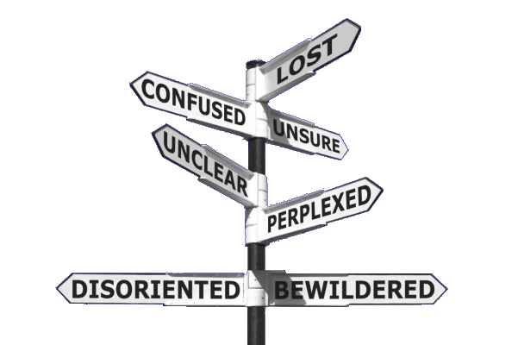

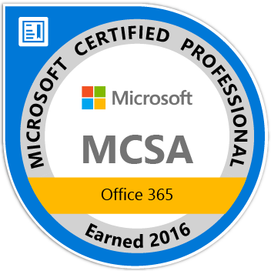

Paul Papanek Stork
Owner/Principal Architect
Don’t Pa..Panic Consulting
Author
Developer’s Guide to WSS 3.0
MOSS 2007 Best Practices
MCTS: WSS 3.0 Configuration Study Guide (70-631)
SharePoint 2010 Development for Office 365
Microsoft Community Contributor
    Technet Forums
    MSDN Forums
    Yammer Groups
Contact Information
Email:
pstork@att.net
Blog:
http://dontPaPanic.com/blog
Twitter:
@PStork
Notes:
Principal SharePoint Architect for BlueChip Consulting Group
http://www.bluechip-llc.com
SharePoint MVP for 9 years
SharePoint Microsoft Certified Master
Author
Developer’s Guide to WSS 3.0
MOSS 2007 Best Practices
MCTS: WSS 3.0 Configuration Study Guide (70-631)
SharePoint 2010 Development for Office 365
Contact Information
Email: Paul.Stork@bluechip-llc.com
Blog: http://dontPaPanic.com/blog
Twitter: @PStork

Slide 3
Automated, Simple, Secure
Backup of Your Office 365 Data
Protect your business from human error, malicious deletion and ransomware in the cloud with one set-and-forget solution.
3 MILLION USERS TRUST BACKUPIFY
• Mail, Calendar, Contacts, OneDrive and SharePoint backup
• Unlimited Storage at no additional cost
• SOC 2 Type II & HIPAA compliant
Try it free for 15 days at Backupify.com

Slide 4
Agenda
What is Business Continuity Management?
Isn't a good Backup all I need? What are RTO and RPO?
What is High Availability (HA)?
What is Disaster Recovery (DR)
HA and DR Design Considerations
Isn't Microsoft handling all this for me in Office 365?

Slide 5
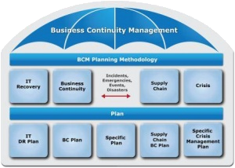
What is Business Continuity Management?
Business Continuity Management (BCM) - an organization-wide discipline that identifies potential impacts which threaten an organization. It provides a capability for an effective response that safeguards the interests of its major stakeholders and reputation.
Including:
Business continuity (BC) planning
Crisis communication (CC) planning
Crisis management (CM) planning
Disaster recovery (DR) planning

Slide 6
Isn't a good Backup all I need?
Backups are Important, BUT!!!!
Backups may still have issues
  Downtime – It can take a long time to restore a Comprehesive Backup
    Recovery Time Objective (RTO) - the duration of time within which a business process must be restored after a disaster (or disruption)
  Lost Data – Backups represent a point in time snapshot so data after that point in time will be lost
    Recovery point objective (RPO) - the maximum period in which data might be lost from an IT service due to a major incident

Slide 7
What is High Availability (HA)?
High Availability (HA)
  A design approach and associated service implementation that ensures a prearranged level of operational performance will be met during a contractual measurement period.
  Should provide an Automated Failover

Slide 8
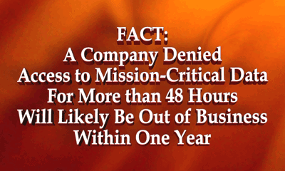
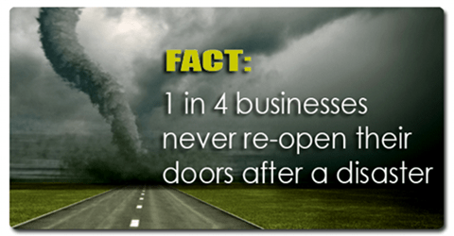
What is Disaster Recovery (DR)?
Disaster Recovery (DR)
  A set of policies, tools and procedures to enable the recovery of technology infrastructure and systems following a natural or human-induced disaster.
  Normally involves manual intervention

Slide 9
Service Level Agreements
Levels of service agreed upon between consumers and suppliers
Usually measured in uptime or availability
Availability % | Downtime / Year | Downtime / Month | Downtime / Week
99% | 3.65 days | 7.20 hours | 1.68 hours
99.9% | 8.76 hours | 43.20 minutes | 10.10 minutes
99.99% | 52.56 minutes | 4.32 minutes | 1.01 minutes
99.999% | 5.26 minutes | 25.90 seconds | 6.05 seconds
99.9999% | 31.50 seconds | 2.59 seconds | 0.61 seconds

Slide 10
Office 365 Service Level Agreements
Service Credits for Missing SLAs
Historical Office 365 Uptime
Monthly Uptime Percentage | Service Credit
<99.9% | 25%
<99% | 50%
<95% | 100%
2015 | 2016 |  |  |  | 2017
Q4 | Q1 | Q2 | Q3 | Q4 | Q1 | Q2 | Q3
99.98% | 99.98% | 99.98% | 99.99% | 99.99% | 99.99% | 99.97% | 99.98%
Reference: https://products.office.com/en-us/business/office-365-trust-center-operations

Slide 11
HA Design Considerations
Remove Single Points of Failure
  Web Front Ends – Requires a Load Balancer
  Service Applications – Services Load Balanced by SharePoint
  SQL Database Server – Physical Cluster or SQL Always On
  Data Center (DR) – If the whole Data Center goes its really DR
Requires balancing Cost vs. Availability
  Duplicating everything can be expensive
  Question of “Where do you stop”

Slide 12
Web Front Ends
HA Considerations
  At least Two Servers
  Load Balancer to distribute traffic
    Not all Load Balancers are suitable for HA (ex. Windows NLB)
DR Considerations
  Need to change DNS to point to new WFEs

Slide 13
Service Applications
Replicate settings for Service Applications that don’t use a database
  Excel Services
  PerformancePoint Services
  PowerPoint Conversion
  Visio Graphics Service
  Work Management

Slide 14
SQL Designs
Physical SQL Cluster
  Requires extra hardware that may be expensive
  Difficult to setup and configure
SQL Always On (Mirroring/Log Shipping in earlier versions)
  Synchronous Replica – Good for HA (requires proximity)
    Not all SharePoint databases supported
  Asynchronous Replica – Good for DR (2014 supports Azure)
Note: Check SharePoint requirements when selecting SQL version

Slide 15
HA & DR Database Support
Database | Synchronous | Asynchronous
SharePoint Configuration | Yes | No – Farm Specific
Central Admin Content | Yes | No – Farm Specific
Site Collection Content | Yes | Yes
Search Admin | Yes | No – Copy can be used to recreate Service
Search Crawl | Yes | No
Search Link | Yes | No
State Service | Yes | No
Usage | Not recommended | Not recommended
User Profile Synch | Yes | No
All Other Services | Yes | Yes
SQL System Databases | No | No

Slide 16
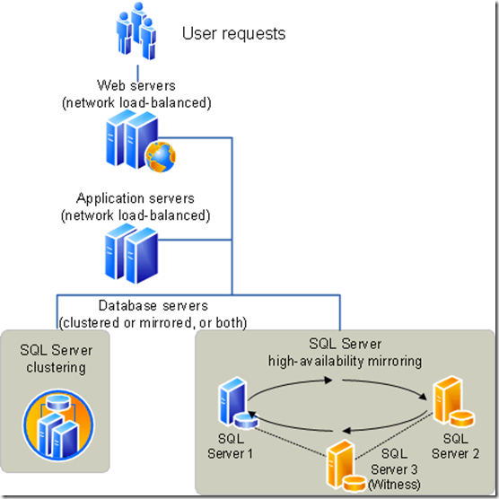
High Availability

Slide 17
DR Design Options
Cold standby: Backups used to restore at a second location AFTER a disaster occurs
  Pros: Often the cheapest option to maintain, but can be an expensive option to recover
  Cons: The slowest option to recover.
Warm standby: Backups used to restore at a second location BEFORE a disaster occurs
  Pros: Often fairly inexpensive to recover, because a virtual server farm can require little configuration upon recovery.
  Cons: Can be very expensive and time-consuming to maintain.
Hot standby: Continuous synchronization to a second location
  Pros: Often fairly fast to recover.
  Cons: Can be very expensive to configure and maintain.

Slide 18
Potential DR Solutions
Backup/Restore
  We’ve already discussed Limitations of Backup
Stretched Farm
  Technical Limitations based on distance
Virtual Machine Failover
  Potential Timing Limitations

Slide 19
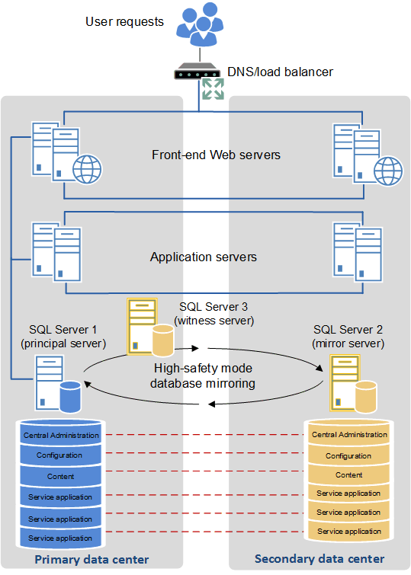
Stretched Farm Support for DR
Limitations
  No more than 1ms latency between components in farms
  Requires bandwidth greater than 1 Gb per second between farms

Slide 20
Virtual Machine Replication/Failover
Based on periodic Snapshots (Backups) of the Servers and Databases
  Frequency of Snapshots will effect RPO and RTO
  Anomalies can arise if Snapshots are not synchronized

Slide 21
Non-Database concerns
Some things are not in the SQL database
  Custom Solutions
  Feature Activations
  IIS and Server configuration changes
  Service Pack and CU patching
Keep Production and DR farms in Sync

Slide 22
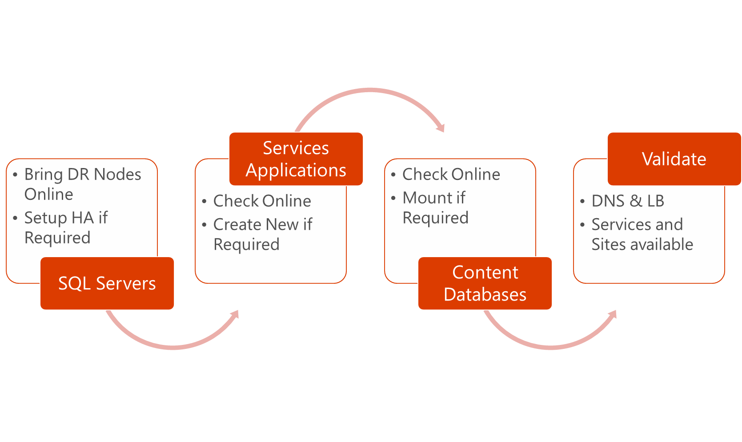
High Level Process – DR Recovery

Slide 23
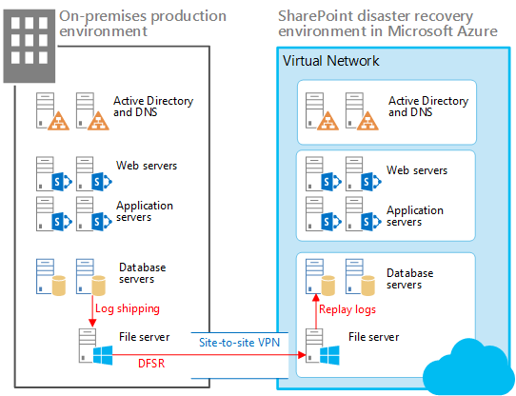
Disaster Recovery

Slide 24
Isn't Microsoft doing all this for me in O365?
Site Collections
  Restore from SharePoint Admin center Recycle Bin
Recycle Bin
  Sites, Lists, Libraries, Folders, Documents, and Items
  Things remain for 93 days max or until Quota exceeded
    Recycle Bin Quota is 200% of Site Collection Quota
    Recycle Bin counts against Tenant storage
OneDrive for Business
  New “File Restore” functionality

Slide 25
Additional resources
Stretched SharePoint Farms vs. Disaster Recovery SharePoint Farms
https://blogs.msdn.microsoft.com/sambetts/2014/04/17/stretched-sharepoint-farms-vs-disaster-recovery-sharepoint-farms/
Disaster recovery best practices and strategies for SharePoint 2013 search
https://technet.microsoft.com/en-us/library/dn715769.aspx
Supported high availability and disaster recovery options for SharePoint databases
https://technet.microsoft.com/en-us/library/jj841106(v=office.16).aspx
Plan for high availability and disaster recovery for SharePoint Server
https://technet.microsoft.com/en-us/library/cc263031(v=office.16).aspx

Slide 26
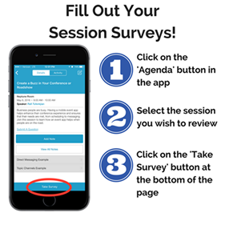
Questions?
Contact Information
  Email: Paul.Stork@dontpapanic.com
  Blog: http://dontPaPanic.com/blog
  Twitter: @PStork

